Slide 1
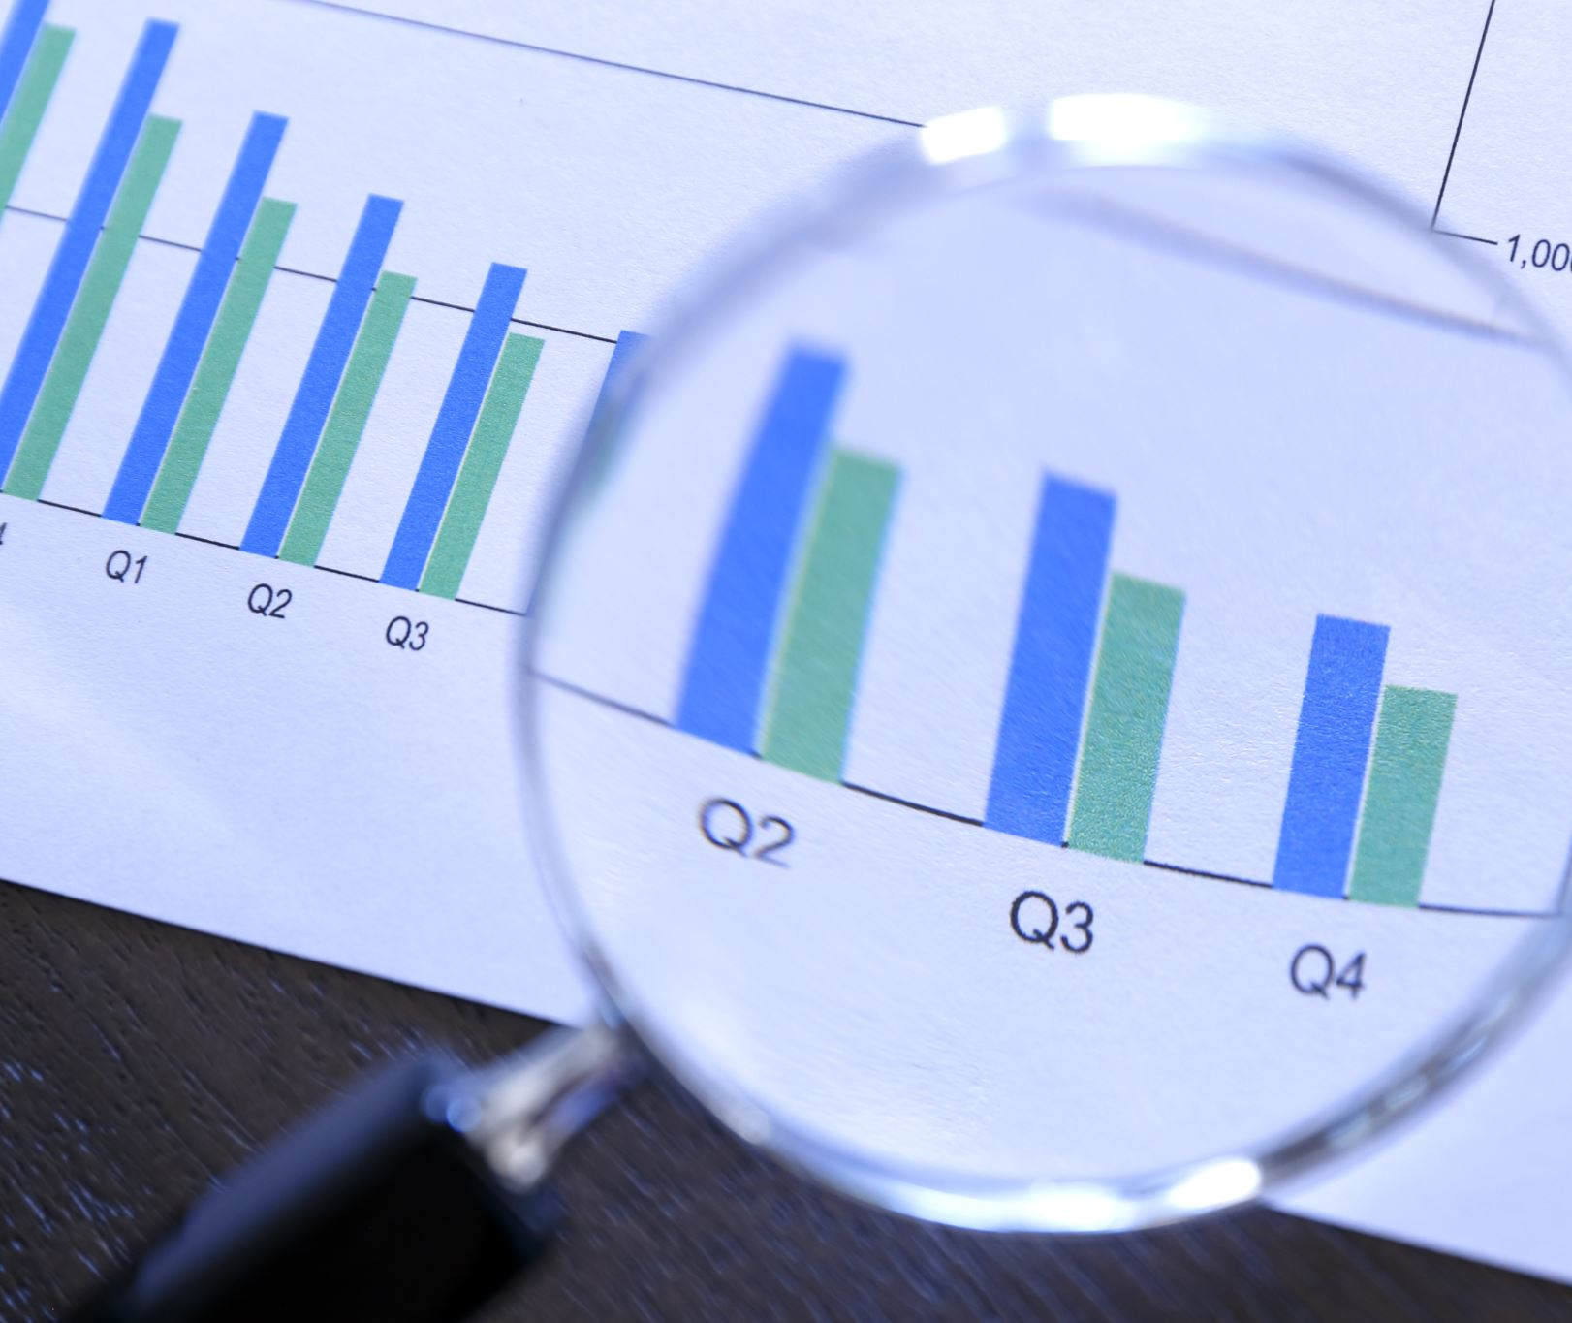
Increasing data reusability through Tidy Data form 2020-12-10
Francisco Juarez
https://orcid.org/0000-0001-5463-9596
Presentation to NTL and BTS

Slide 2
Intro
Graduate Student
Library and Information Science
The University of Illinois at Urbana-Champaign
Graduate Assistant
Grainger Engineering Library
Notes:
I am a Practicum Student under The National Transportation Library (NTL)
A Graduate Student at the University of Illinois at Urbana-Champaign pursuing a Masters in Library Information Science
I am also a Graduate Assistant at the Grainger Engineering Library working with the Libra

Slide 3
About the National Transportation Library
Transportation Equity Act for the 21st Century (TEA-21) (1998)
“establish and maintain a National Transportation Library, which shall contain a collection of statistical and other information needed for transportation decision making at the Federal, State, and local levels.”
Moving Ahead for Progress in the 21st Century Act (MAP-21) (2012)
Acquire, preserve and manage transportation information and information products and services for use by DOT, other Federal agencies, and the public;
Serve as the central repository for DOT research results and technical publications; and,
Serve as the central clearinghouse for transportation data and information of the Federal Government
White House Office of Science and Technology Policy memo (2103)
requiring all Executive Departments and Agencies spending more than $100 million/year on R&D to ensure public access to peer-reviewed publications and digital datasets arising from federally-funded scientific research
Foundations for Evidence-Based Policymaking Act of 2018, Title II: The Open, Public, Electronic, and Necessary Government Data Act (OPEN Government Data Act)
Notes:
among all statistical agencies
In the government
the Bureau of Transportation Statistics (BTS) is unique in that it has their own Library, NTL
Within NTL they have their own data curator and data curation team,
Compromising of jesse long and Leighton Christiansen
Who I had the pleasure of working with

Slide 4
Agenda
Focus Project (GTFS)
Data Packages
Challenges
Tidy Data

Slide 5
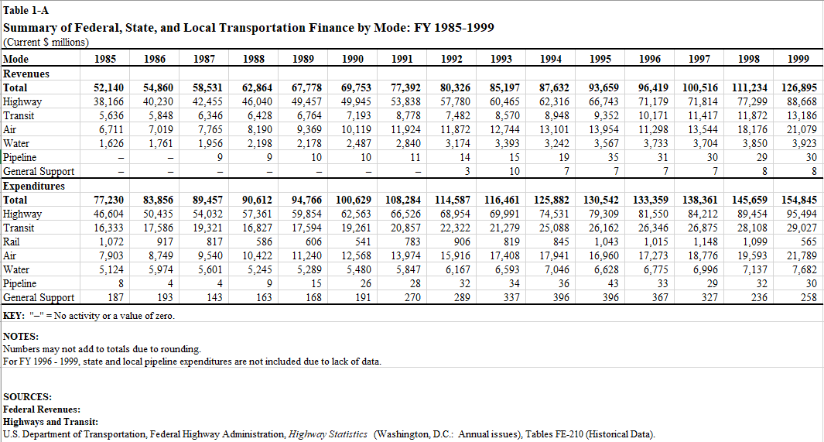
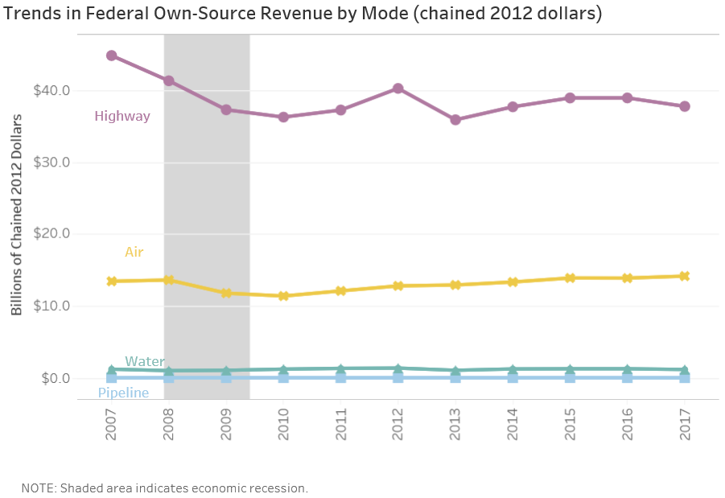
Government Transportation Financial Statistics(GTFS)
Series of reports covering transportation-related financial actives of all US government levels
The government plays an important role in the U.S. transportation system, as a provider of transportation infrastructure and as an administrator and regulator of the system.
Responsibility to provide records outlying the financial partitioning to the public
Useful for viewing trends over the years
Notes:
What is GTFS?
Series of technical reports covering transportation-related financial activities of the federal,
state and local governments for Fiscal Years. These financial activates finance most of their outlays by providing services to the public.
These reports focus on the role of the government as transportation infrastructure system
Some broad categories of data you'll find in these report… you have things like
- Federal revenues and expenditures by mode and program
- Federal grants to state and local governments by mode
- Federal budget authority and obligations by mode and program
- State government revenues and expenditures by mode for the fifty states
- Local government revenues and expenditures by mode for the fifty states and the District of Columbia
The essential component of the Government Transportation Financial Statistics reports is the documentation of transportation trends throughout the years. Something better presented in visual graphs in more recent reports
Trends
Trends in the distribution of government revenues and expenditures among the different modes of transportation
Trends in federal grants to state and local governments by mode
Trends in federal, state and local transportation revenues and expenditures
Changes in the distribution of government transportation revenues and expenditures by level of government
** Describe the table as an example of how the data is presented in the report**
The Data presented in these reports vary but they all share the time interval, key, notes, source, and units ( recorded as usd million) and are all record as tables
Units in million USD
Time of recorded data (for The GTFS 2001 tables ranging from 1985-2000 Fiscal Years)
This table on screen represents the summary of all levels of government transportation finances with respect to mode

Slide 6
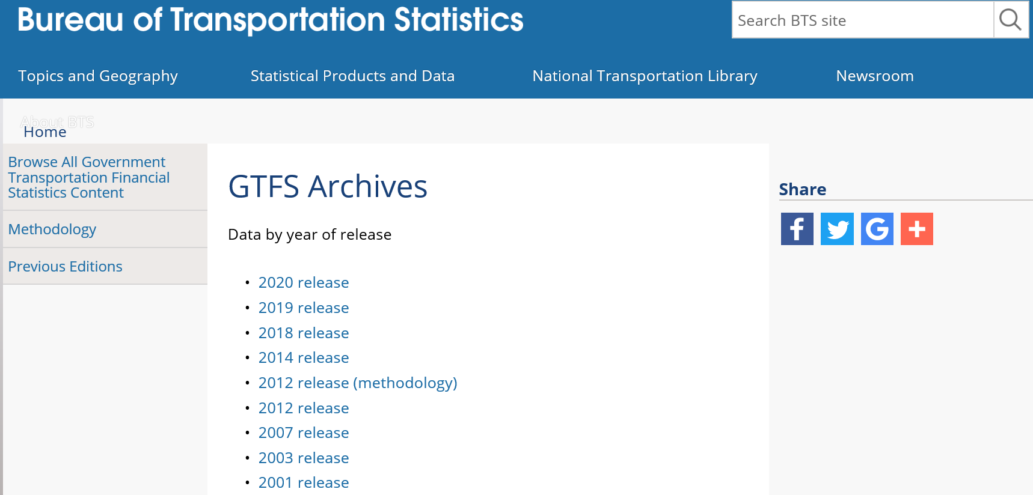
Government Transportation Financial Statistics (GTFS) datasets
Goal:
- Archive all but the current GTFS report into ROSA P instead of BTS.gov
- All archive GTFS datasets to have accompanying data packages
Currently all GTFS report are stored in a bts.gov landing page
Notes:
Dealing with legacy data
Plan is to create data packages for these old reports and migrate them onto Repository & Open Science Access Portal (ROSA P) for preservation
Currently all of them are in BTS.gov but we only want the most current report there

Slide 7
Data Package
What is a “Data Package”
Dataset
Data Management Plan
All other documentation needed to contextualize the data set for all users and re-users
Notes:
Briefly mentioned this but
A data package is the dataset and all documentation needed to contextualize the dataset for any and all users
Four required Elements for NTL’s data packages
Dataset
Readme.txt
Metadata file
Data Management Plan
The image on top has a summarization of all the contents in a data package
While the image in the bottom is all the contents from a zip download of a data package, mentioned precviously
These packages are meant to comply with the fair principles
Findable
Accessible
Interoperable, which is huge,
Re-usability
For example, everything on these packages is open source and nonproprietary, and complies with data packaging best practices
Best practice: Use consistent, descriptive, human-readable file names, with data and timestamps to help your data package well organized and up to date
Metadata:
Metadata Schema is the Project Open Data Metadata used by data.gov
Metadata helps with discoverability and is an effective means of organizing electronic resources and is required by law to have data be findable
A data Management Plan which is retroactively created for legacy data
NTL data management Plan contains 5 sections
Data Description
Standards Employed
Access Policies
Re-use, Redistribution, and Derivative Product Policies
Archiving and Preservation Plans
Data Management is essential in all stages of a data project
From Planning, Acquisition, Processing, Analyzing, Preservation, and Publishing/Sharing
Poor data management results in challenges with finding, organizing, and preserving data in the future. Leading to poor use and a waste of money.
For example, why recreate or create a new study when a previous studies data can provided the needed information necessary. Just a question of being able to find the information

Slide 8
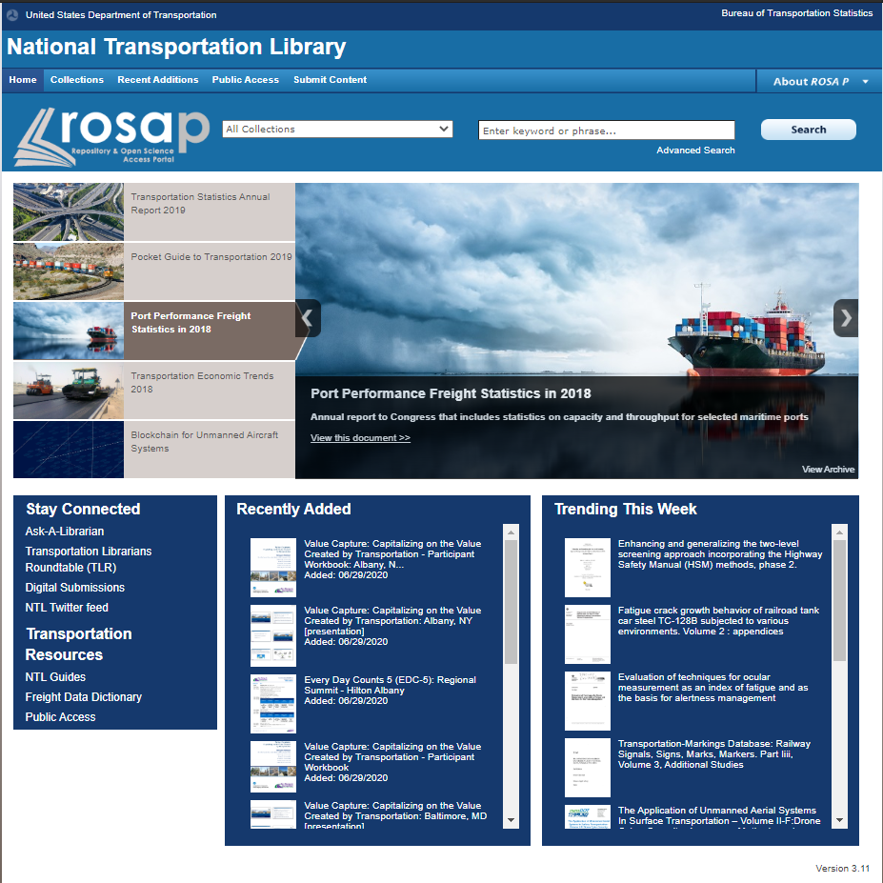
Repository & Open Science Access Portal (ROSA P)
ROSA P is the National Transportation Library's Repository and Open Science Access Portal. The name ROSA P was chosen to honor the role public transportation played in the civil rights movement, along with one of the important figures, Rosa Parks.
Visit ROSA P at: https://rosap.ntl.bts.gov/welcome
Notes:
As mentioned the goal is to archive all GTFS datasets within ROSA P
Here we have a screenshot of ROSA P’s home page

Slide 9
Challenges
Legacy Data lacking proper data management.
Confusing or undescriptive filenames (e.g., “table_01a.csv”)
Accessibility of datasets
Insufficient Documentation
Deciphering data
Large volume of dataset
Notes:
Some of the challenges needed addressing when dealing with legacy data
We have improper filenames, data accessibility, insufficient documentation, and retroactively creating the data management plan
For this presentation I want to focus on increase reusability of the datasets
For example, the GTFS 2007 report is unique in that it contains no narrative only tables
The preservation of the datasets themselves are an issue.
With a report that lives of dies off its data requires that the data meet certain standards
We want these datasets ready for analysis and as such they require a certain level of cleaning
In general, I found that the current presentation of the GTFS datasets
challenging to work with for analysis

Slide 10
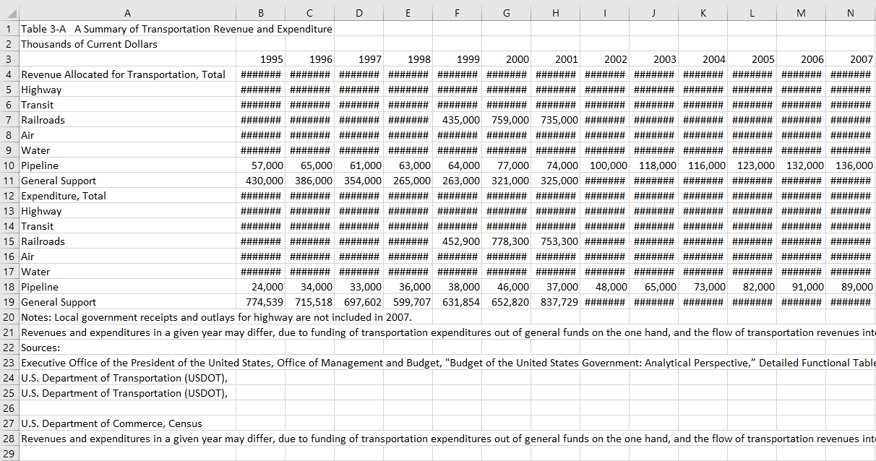
10
Notes:
The presentation of the datasets in a spreadsheet platform are
understandable for humans
We have the title here and at the bottom you can other meta data like the notes and sources.
A total row for all transportation modes and years nicely parsed

Slide 11
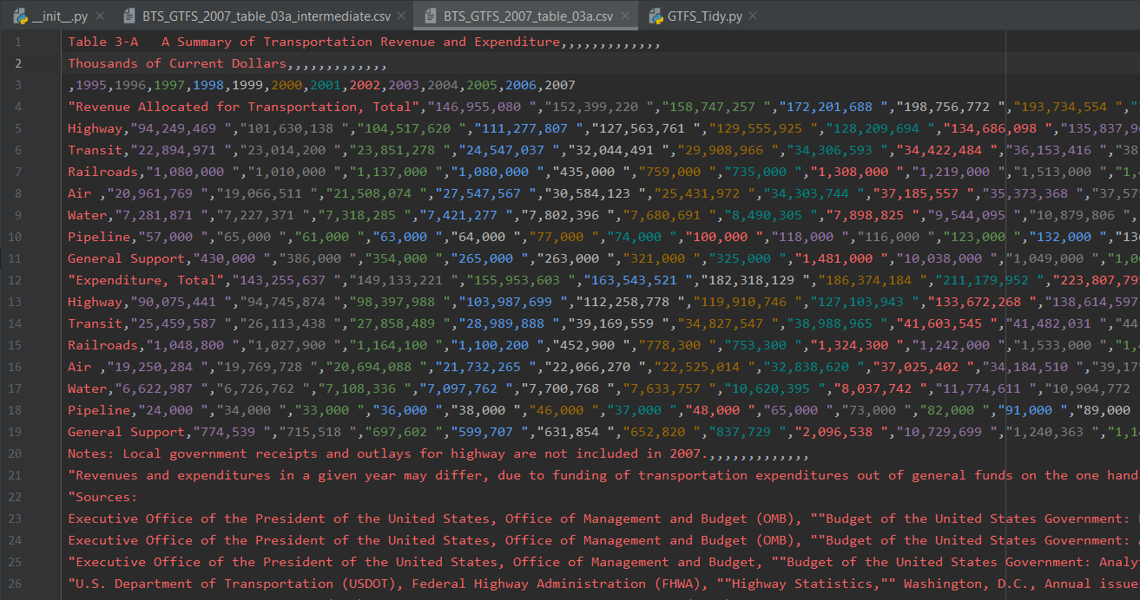
11
Notes:
But for machines the csv require some cleaning
Here you can see that there are no headers making the data difficult to parse. The total row leads to complication when trying work on some operations like getting a sum or average.
So, I wanted to focus on the accessibility of the datasets. Getting them ready for analysis

Slide 12
12
Notes:
In this slide you have a short python script
In general, had the csv been properly formatted this would of returned al the headers
And it’s a common start when someone wants to begin analyzing the data. The lack of proper data structure is a barrier for user who are interested on working with it.

Slide 13
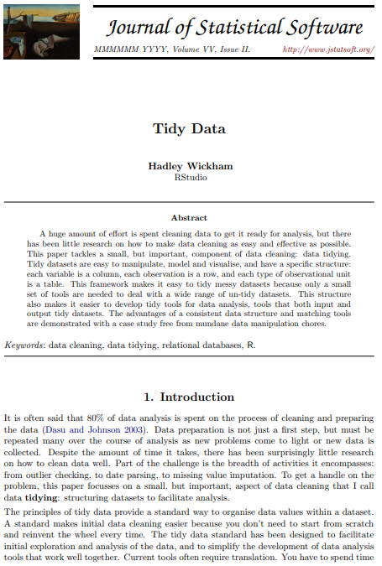
Tidying:
structuring datasets to facilitate analysis.
Wickham H., (2014). Tidy Data The Journal of Statistical Software, vol. 59(10). Retrieved December 9, 2020, from https://vita.had.co.nz/papers/tidy-data.html
Notes:
So we want to clean this data some way. But what does it mean to clean data?
Let’s talk about tidy data and what it means when your data is
Quote on quote clean
there is this nice paper by Hadley Wickham
Come from the R world, but stuff like this is totally relevant
It’s language agnostic
In the paper Hadley addresses what it means to have clean datasets providing a proposed standard for minor cleaning and and defines tidying as structuring datasets to facilitate analysis
The paper is available as an open access resource
I’ll have a link in the reference of this presentation but a google search of
Tidy data and Hadley works too, for those interested in reading into it

Slide 14
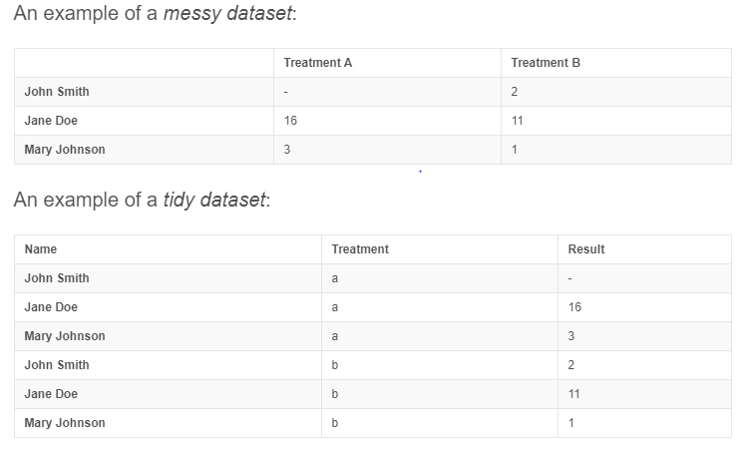
14
Notes:
Here we have and example of two representation of data, tidy and messy
They both contain the same information just structured differently.
And I want to address some reasons why the bottom one is the clean dataset by describing what you can do with it that the top display cannot
Let’s imagine you have a model, a statistical model,
With some result based off from treatment
You can now fit a model where result is your dependent variable while treatment is your independent x
You have columns for that
Vs dataset like the top
Where you don’t really have a column that represents response or input variables
That’s sort of one visual que for clean data
The other thing
Once you get a dataset to tidy form it’s really easy to convert it to whatever you need.
For example, the top one is easy to interpret and check treatment a and treatment b for a person
What I’m getting at is
That there are different version of dataset that serve different purposes
but once you get your data into clean and tidy format it’s easy to convert it to one another

Slide 15
Defining Tidy data
Each variable forms a column and contains values
Each observation forms a row
Each type of observation unit forms a table
Notes:
Data cleaning happens a lot in data science. Around 80% reported of the time for analysis is spent on cleaning data
No matter what kind of data you are dealing with or what kind of analysis you are performing,
you will have to clean the data at some point.
In this slide you have the formal definition of tidy data from Hadley’s paper
-
tidy data provide a standard way to organize data values within a dataset.
A standard makes initial data cleaning easier because you don’t need to start from scratch and reinvent the wheel every time.
I left everything I left in one piece

Slide 16
Five common problems with messy datasets
Variables are stored in both rows and columns
Multiple variables are stored in one column
Column headers are values, not variable names
Multiple Types of observational units are stored in the same table
A single observational unit is stored in multiple tables
Notes:
In general,
Hadley Wickham describes five of the most common problems
with messy datasets. Those five common problems are displayed on this slide
For this presentation, the dataset I worked with violated the “column headers are values, not variable names”
However,
Keep in mind that all messy data is unique and requires different approaches to get it “tidy”
Remember that All tidy data is the same but messy data is different in it’s own way

Slide 17
Column headers are values, not variable names
Notes:
GTFS 2007 issue

Slide 18
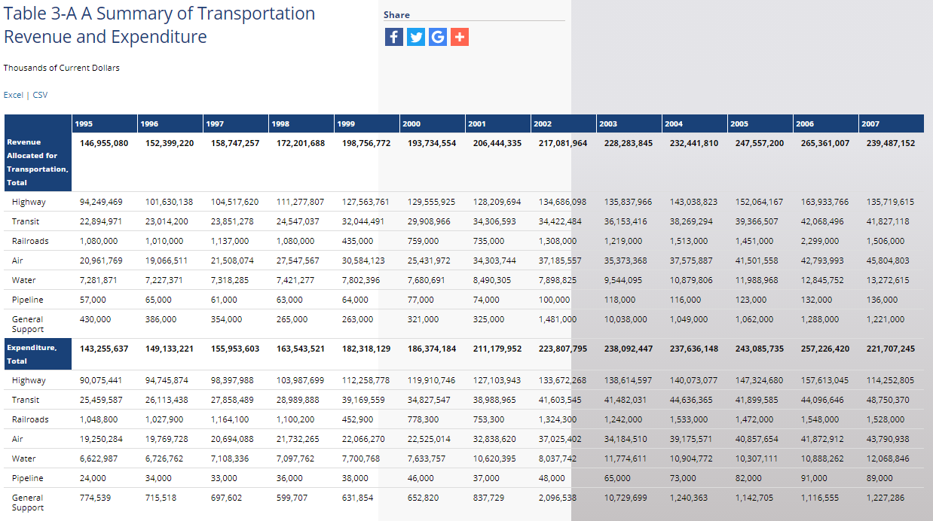
18
Notes:
Removal of the total row necessary
The visual has two tables
One for expenditure and another for revenue just stacked on top of one another
We can address this by making a column and the values of that column are either expenditure or revenue
The columns for this data range from 1995 – 2007, representing values
Headers should represent variable so to get this data to dity form we’ll have to merge the years into one column named ‘year’ and then another header called USD containing the money value

Slide 19
19
Notes:
Here we have the intermediate quote on quote “clean” dataset where I manually produced. The big change from this is that we removed metadata like the notes and sources from this table as well as title and now the first row reflects only headers
Adding transportation mode
Highway, transit, railroads, air, water, pipeline, and general support and creating a header to describe if the observation is in reference to revenue or expenditure of that transportation mode for that year
‘
Quick notes to explain these pound symbols
The data is saves in test form in the csv so when a spread sheet like excel reads it when ever it’s too long to display in the given width excel defaults to the symbols you see infront of you
The information is all there fortunately
If the data is saved as a numeric type excel instead would have the values represented in scientific notation when they get too long

Slide 20
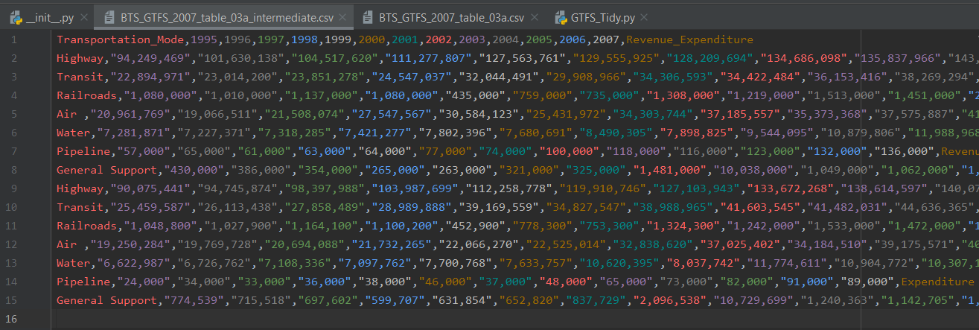
20
Notes:
If we go and open this up in a python environment as a csv
It already looks nicer than the currently saved dataset in bts.gov

Slide 21
21
Notes:
And if we try to use the csv library from python to read the headers we now have something returned in the intermediate dataset

Slide 22
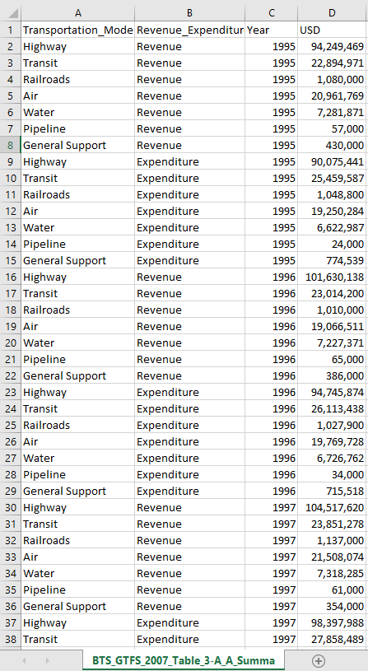
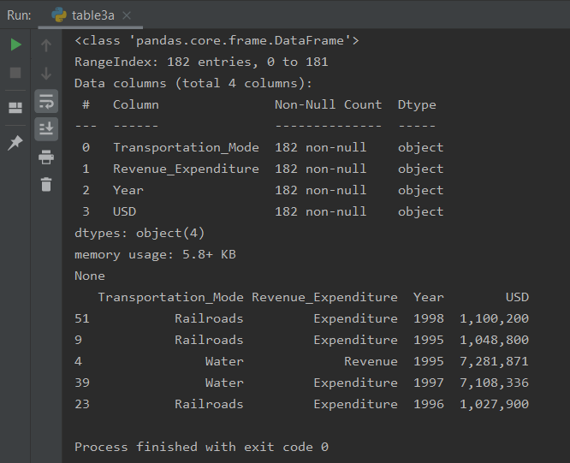
Results
Notes:
I want to make it clear that in not way am I intending to have the tidy form datasets replace what GTFS 2007 already has but rather I plan to amend them to the data package and provide documentation on what it is and how it can be used. It’s mean to supplement to existing datasets. As mentioned previously, the benefit of the tidy form is that it’s data ready to be analyzed but there are some tables that visually look well as they are in the report and we have full intentions of keeping them.
I left everything I own in one piece

Slide 23
Conclusion
I suggest Federal dataset reports to incorporate a data cleaning process standard
Structuring datasets to facilitate analysis is an essential component for increasing re-usability
Tidy datasets are easy to
Manipulate
Model
Visualize
Have a specific structure
column = variable
row = observation
table = observational unit type
Notes:
I suggest Federal dataset reports to incorporate a data cleaning process standard in their data management plan in the future.
A standard makes initial data cleaning easier because you don’t need to start from scratch and reinvent the wheel every time.
The principles of tidy data are closely tied to those of relational databases and Codd’s relational algebra (Codd 1990), but are framed in a language familiar to statisticians.
structuring datasets to facilitate analysis is an essential component that increases re-usability
A huge amount of effort is spent cleaning data to get it ready for analysis, with some reports recording 80% of the data analysis portion partitioned solely to cleaning data (Dasu and Johnson 2003).
but there has been little research on how to make data cleaning as easy and effective as possible.
Applying Hadley Wickham's Tidy Data to preserve datasets is a small step forward in the right directions to remove the barrier for reusability.
Tidy datasets are easy to
Manipulate
Model
Visualize
And have a specific structure (column = variable, row = observation, table = observational unit type)
tidy data provide a standard way to organize data values within a dataset.
A standard makes initial data cleaning easier because you don’t need to start from scratch and reinvent the wheel every time.

Slide 24
References
Wickham H., (2014). Tidy Data The Journal of Statistical Software, vol. 59(10). Retrieved December 9, 2020, from https://vita.had.co.nz/papers/tidy-data.html
Daniel chen: Cleaning and tidying data in pandas | pydata dc 2018—Youtube. (n.d.). Retrieved December 10, 2020, from https://www.youtube.com/watch?v=iYie42M1ZyU
Tidy data in python · jean-nicholas hould. (n.d.). Retrieved December 10, 2020, from https://www.jeannicholashould.com/tidy-data-in-python.html

Slide 25
Awknoledgements
Bertram Ludäscher
Professor and Director, Center for Informatics Research in Science and Scholarship
Leighton L Christiansen
Librarian/Data Curator, National Transportation Library, U.S Department of Transportation.
Hoa Luong
Assistant Director Research Data Curation, Research Data Service at University of Illinois at Urbana-Champaign
Ashley Hetrick
Data Analyst at the University of Illinois at Urbana-Champaign

