Slide 1
Evaluating Data Management Plans (DMPs)
Leighton L Christiansen 0000-0002-0534-4268
Data Curator,
National Transportation Library,
Bureau of Transportation Statistics,
OST-R, US Department of Transportation
leighton.christiansen@dot.gov
ntldatacurator@dot.gov
Jesse Long 0000-0002-4962-1380
Data Curation & Data Management Fellow,
National Transportation Library,
Bureau of Transportation Statistics,
OST-R, US Department of Transportation
jesse.long.ctr@dot.gov
Zoe Mann 0000-0002-0198-0915
STIPDG Intern,
National Transportation Library,
Bureau of Transportation Statistics,
OST-R, US Department of Transportation
zoe.mann.ctr@dot.gov
Researchers’ Development of a Data Management Plan: Session 2
For Federal Aviation Administration
2021-08-04
Notes:
Jesse: Intro
Welcome to today’s training: Evaluating Data Management Plans (DMPs). This is Session 2 of the series Researchers’ Development of a Data Management Plan, for the Federal Aviation Administration.
Our presenters today are Zoe Mann, Leighton Christiansen, and I am Jesse Long.

Slide 2
Workshop Schedule
Wednesday, July 28:
Workshop 1:
Data Management Plans (DMPs) for Research Proposals
Wednesday, July 28 to Monday August 2:
Homework:
Writing Your DMP
Wednesday, August 4:
Workshop 2:
Evaluating Data Management Plans (DMPs)
Notes:
Jesse: go over schedule [1 minute or less]
Let’s take a quick look at the Workshop Schedule. We have been working on our data management plans (DMPs) since the first workshop on July 28. Today, we are going to learn to evaluate those DMPs.

Slide 3
Workshop 2 Overview
Discussion: Writing a DMP was harder than I thought (20 min)
How to Evaluate a DMP (10 min)
Evaluating CFS 2017 DMP (20 min)
Each Breakout Room, working as a group on assigned section of DMP
Break (10 minutes) (0.50 to 1.00)
Report back (25 min)
Each Breakout Room (5 minutes each)
DMP Self-Evaluation (25 min)
Break (10 minutes) (1.50 to 2.00)
Volunteers Sharing Results (25 min) (2.25)
Questions & Discussion from Session 1 & 2
Notes:
Jesse: Go over schedule [1 minute]
The schedule for today is:
Discussion: Writing a DMP was harder than I thought (20 min)
How to Evaluate a DMP (10 min)
Evaluating CFS 2017 DMP (20 min)
Each Breakout Room, working as a group on assigned section of DMP
Break (10 minutes) (0.50 to 1.00)
Report back (25 min)
Each Breakout Room (5 minutes each)
DMP Self-Evaluation (25 min)
Break (10 minutes) (1.50 to 2.00)
Volunteers Sharing Results (25 min) (2.25)
Questions & Discussion from Session 1 & 2

Slide 4
Discussion: Writing a DMP was harder than I thought
Participant feedback:
There were many prompts in the DMP I could not answer. What do I do?
That is expected. DMP writing may be a team sport.
You may not have all of the answers at proposal writing time, but in order to be a good data manager, you should think through the questions at proposal time.
Persistent links may not exist until near end of project, once archive record is created.
DMP Guidance web pages useful. More examples would be nice.
Noted. Site redesign starting Fall 2021
DMPTool has many templates, but none for my discipline.
DMPTool is NOT a DOT-managed system. Has been used for years by other disciplines.
But we can craft and upload templates that make sense for DOT research units.
In DMPTool, how do I…?
We will add DMPTool training and tips to Guidance website.
Others from the live audience?
Notes:
Jesse: lead discussion of the DMPs that folks wrote. [up to 20 minutes]
Slide title: Discussion: Writing a DMP was harder than I thought
We got some great feedback via email from the first session. We have replied to 4 of these here:
There were many prompts in the DMP I could not answer. What do I do?
That is expected. DMP writing may be a team sport.
You may not have all of the answers at proposal writing time, but in order to be a good data manager, you should think through the questions at proposal time.
Persistent links may not exist until near end of project, once archive record is created.
DMP Guidance web pages useful. More examples would be nice.
Noted. Site redesign starting Fall 2021
DMPTool has many templates, but none for my discipline.
DMPTool is NOT a DOT-managed system. Has been used for years by other disciplines.
But we can craft and upload templates that make sense for DOT research units.
In DMPTool, how do I…?
We will add DMPTool training and tips to Guidance website.
Now let us take some feedback from the live audience:

Slide 5
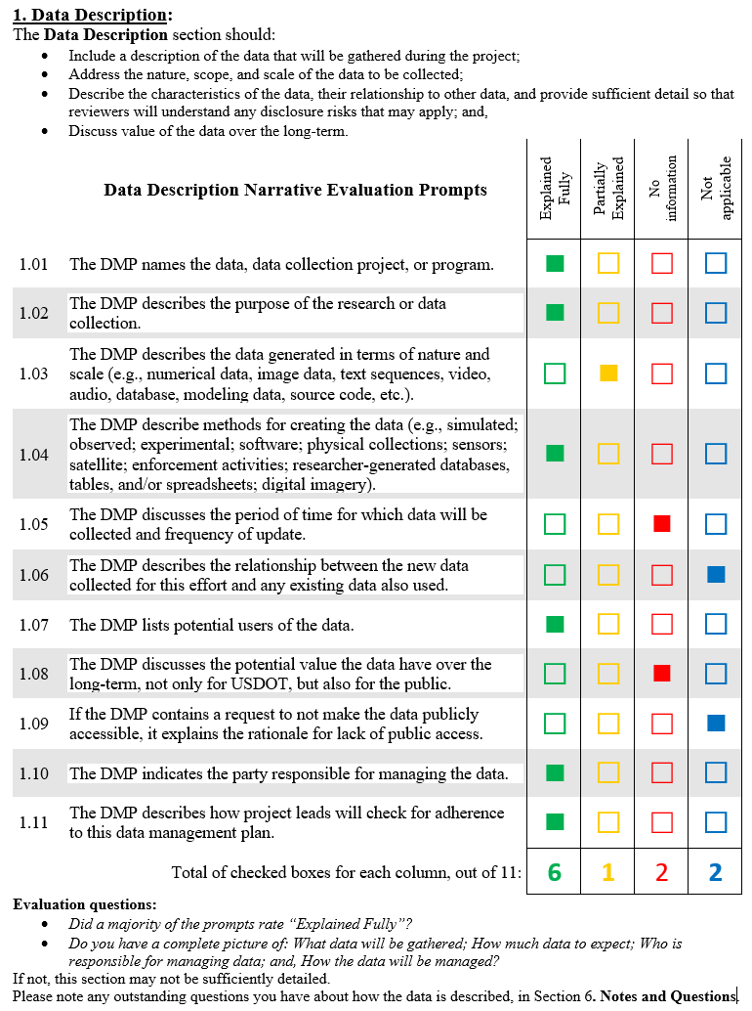
How to Evaluate a DMP
Read over CFS 2017 DMP
Use supplied checklist to check each section
Tally scores
Communicate results
Notes:
Leighton: [next 3 slides: 10 minutes]
Slide title: How to Evaluate a DMP
Speaker text: We are about to go into an exercise where you will get to evaluate a data management plan written by National Transportation Library staff. And you will get a chance to use the DMP evaluation checklist we have created to give that DMP a score. This will help you decide if the DMP is sufficient.
To summarize the actions we will take:
Read over CFS 2017 DMP
Use supplied checklist to check each section
Tally scores
Communicate results

Slide 6
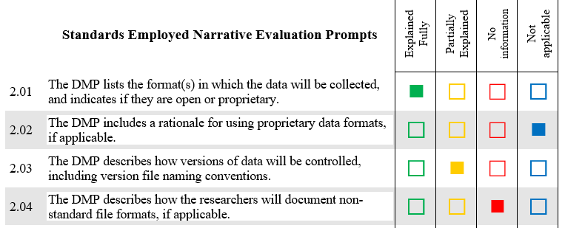
The Art of Evaluating a DMP
Some science; some art
Not all apply
Quantitative tool for qualitative decision
Notes:
Leighton
Slide title: The Art of Evaluating a DMP
Speaker text:
Here are some tips to keep in mind about the checklist:
There is some science to evaluation, there is some art. Some prompts have obvious correct answers or information needed. The answers to other prompts may be adequate, but you may wish for more information.
Not all prompts apply to all data collection actions. The DMP template is created for the general case, and not all apply.
This checklist is a quantitative tool to help you make, in the end, what is an actually qualitative decision: Is this DMP sufficient for me to trust the researcher will take good care of the data the DOT is funding?

Slide 7
Evaluation Exercise
Evaluate CFS 2017 DMP (20 min)
Use Sufficiency Eval form (1 note taker per breakout room)
Each breakout room, working as a group
Room 1: Section 1
Room 2: Section 2
Room 3: Section 3
Room 4: Section 4
Room 5: Section 5
Record consensus answer; note debate
Some section are longer; you may not finish
Notes:
Leighton
Slide title: Evaluation Exercise
Speaker notes:
We are going to have 20 minutes to evaluate the 2017 Commodity Flow Survey data management plan. But you will not have to evaluation the entire DMP on your own.
We are going to break the attendees up into 5 random breakout rooms, where you will work as a group, one just 1 section of the DMP. Each room will evaluate the DMP section that correspond to the room number, so:
Room 1: Section 1
Room 2: Section 2
Room 3: Section 3
Room 4: Section 4
Room 5: Section 5
Each of you should record the consensus answer on the prompt on your own DMP evaluation checklist, so you get used to using it.
Also note any debate.
Since some section have 11 prompts, and others have only 5 prompts, you may or may not get through all of the prompts. That is ok.

Slide 8
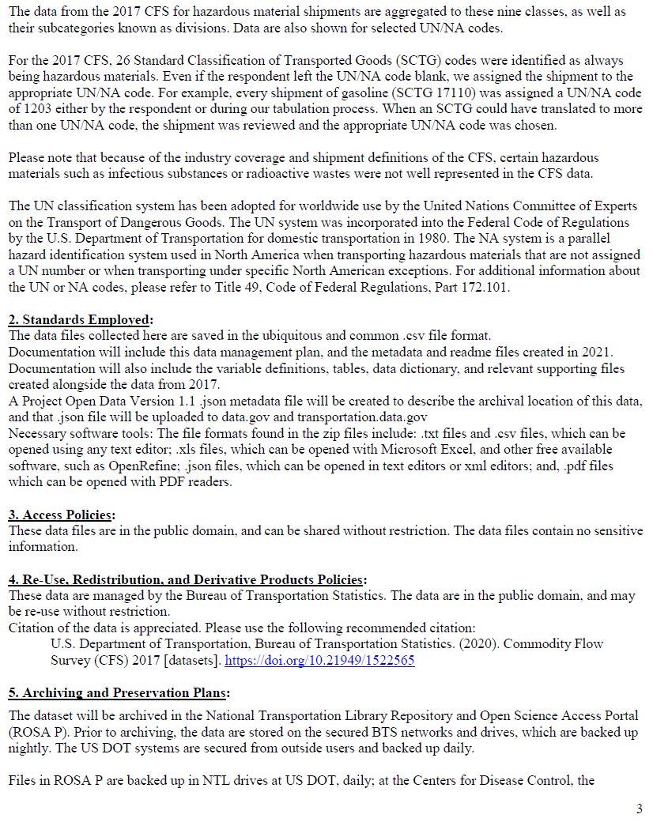
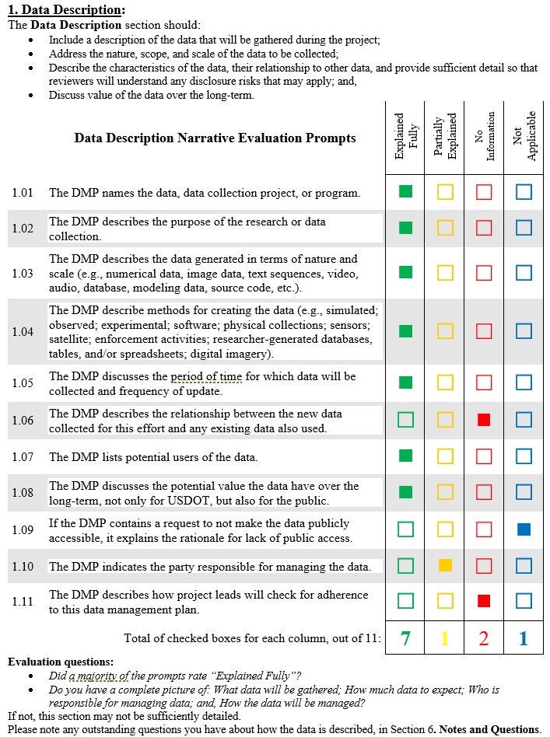
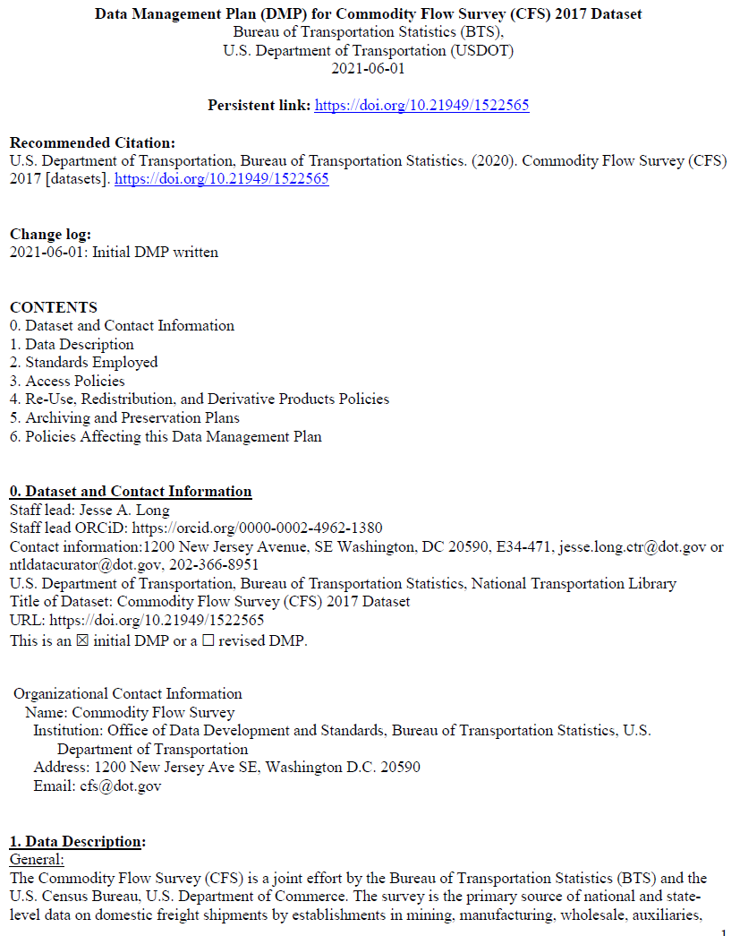
Commodity Flow Survey 2017 [supporting datasets]
Notes:
[holding here 20 minutes]
Zoe:
Please take 20 minutes to evaluate the Commodity Flow Survey 2017 DMP that was emailed out by Mike. File out the evaluation checklist that Leighton described in relationship to that DMP.
This is your change to grade the work of the NTL.
If you finish early, you can go on break early. We plan to get back together at the top of the hour.
NTL staff will stay in the room to answer questions.
[Next slide at break time.]

Slide 9
Break: 10 Min
Notes:
[Time check: 50 minutes]
10 minute break
[60 minutes at end of break]
[NEXT SLIDE]

Slide 10
Report Back
CFS 2017
Room 1: Section 1
Room 2: Section 2
Room 3: Section 3
Room 4: Section 4
Room 5: Section 5
Notes:
Zoe:
Welcome back from the break.
During the Report Back section, we are going to ask for at least 1 person from each breakout room to report back on how they evaluated the Commodity Flow Survey 2017 DMP created by NTL.
Your room can also raise questions about that section of the DMP template or the Sufficiency Checklist tool.
We will also show you how we at NTL self-evaluated the same section. We will also mention areas for improvement or clarification we found as well.
Ok, let’s go to the Data Description Section, and breakout room 1. Who from that room is going to come on mic or camera and share your evaluation?
[Next Slide]

Slide 11
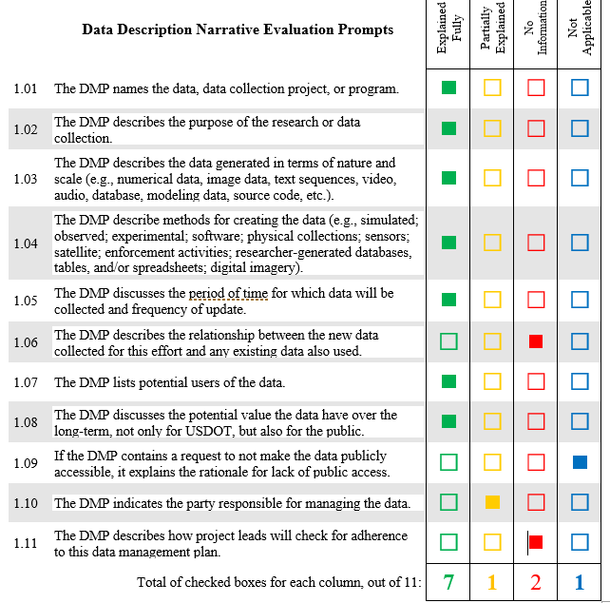
CFS 2017: 1) Data Description
The Commodity Flow Survey (CFS) is a joint effort by the Bureau of Transportation Statistics (BTS) and the U.S. Census Bureau, U.S. Department of Commerce. The survey is the primary source of national and state-level data on domestic freight shipments by establishments in mining, manufacturing, wholesale, auxiliaries, and selected retail and services trade industries located in the 50 states and the District of Columbia. Data are provided on the type, origin and destination, value, weight, modes of transportation, distance shipped, and ton-miles of commodities shipped. The CFS is conducted every 5 years as part of the economic census. It provides a modal picture of national freight flows and represents the only publicly available source of commodity flow data for the highway mode. The CFS was conducted in 1993, 1997, 2002, 2007, 2012, and most recently in 2017.
The CFS assesses the demand for transportation facilities and services, energy use, and safety risk and environmental concerns. CFS data are used by policy makers and transportation planners in various federal, state, and local agencies. Additionally, business owners, private researchers, and analysts use the CFS data for analyzing trends in the movement of goods, mapping spatial patterns of commodity and vehicle flows, forecasting demands for the movement of goods, and determining needs for associated infrastructure and equipment.
The CFS publication provides data by shipment characteristics of commodities transported in the U.S. The publication data series include the geographic area series, temperature control series, exports series, and hazardous materials series.
Notes:
Zoe: lead attendee feedback (3 or 4 minutes)
Zoe: Now I am going to ask Jesse to talk about how we evaluated this section.
Jesse: One thing to keep in mind about this DMP: this is a DMP written for a dataset that was already created, and was written as we were preparing to archive the dataset in the NTL repository. So, this is a “preservation DMP,” rather than a “proposal DMP” or “research DMP.” This means we can be more complete with some information. But other information is missing because we weren’t part of the data collection process, and no one who was was able to advise us.
For Data Description, we self-scored
Explained Fully: 7
Partially Explained: 1
No Information: 2
Not Applicable: 1
This eval section saw the most variation between Zoe, Leighton, and myself.
We all agreed this section was pretty complete. However, we agreed wanted more description of the actual dataset as a discrete, abstract object.
We also wanted some explanation on who was responsible for managing this data into the future.
Let’s go on to Section 2 Standards Employed. [Next Slide]

Slide 12
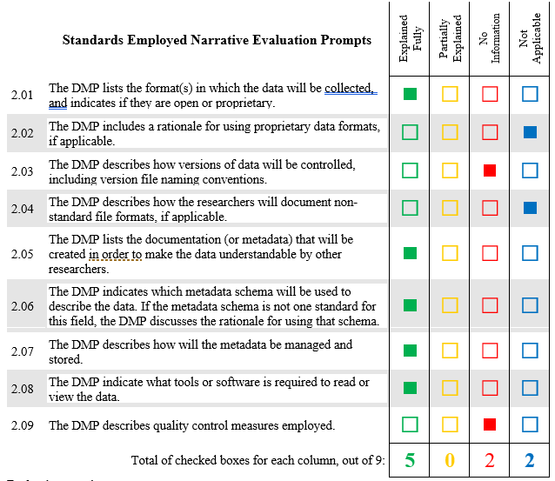
CFS 2017: 2) Standards Employed
The data files collected here are saved in the ubiquitous and common .csv file format.
Documentation will include this data management plan, and the metadata and readme files created in 2021. Documentation will also include the variable definitions, tables, data dictionary, and relevant supporting files created alongside the data from 2017.
A Project Open Data Version 1.1 .json metadata file will be created to describe the archival location of this data, and that .json file will be uploaded to data.gov and transportation.data.gov
Necessary software tools: The file formats found in the zip files include: .txt files and .csv files, which can be opened using any text editor; .xls files, which can be opened with Microsoft Excel, and other free available software, such as OpenRefine; .json files, which can be opened in text editors or xml editors; and, .pdf files which can be opened with PDF readers.
Notes:
Zoe: Ok, who will volunteer from breakout room 2 to share the evaluation of the Standards Employed section?
[3 to 4 minutes of input]
Thanks. Jesse will you please talk about NTL’s feedback on this section?
Jesse:
For Standards Employed, we self-scored
Explained Fully: 5
Partially Explained: 0
No Information: 2
Not Applicable: 2
I want to point out that our answer in 2.01, that the data is in the public domain, means that the prompt 2.02 is no longer applicable. If this was a web-based form or survey tool, there could logic programmed to skip over 2.02.
The short comings in this section included no discussion about file naming or data quality control.
Let’s go to Access Policies. [Next Slide]

Slide 13
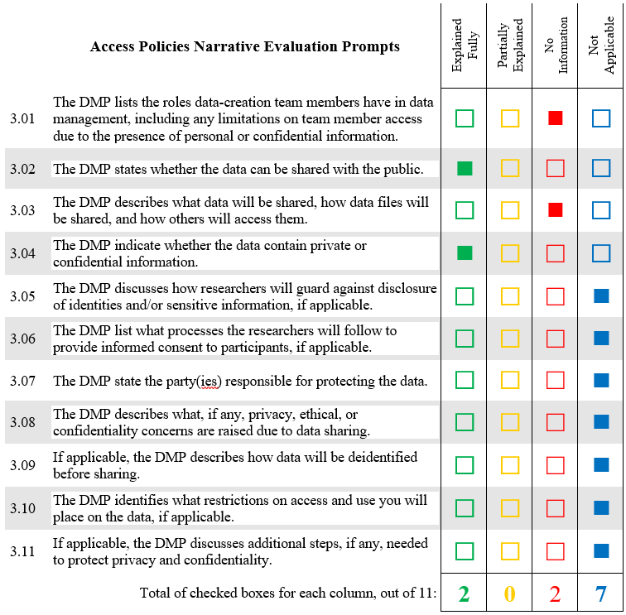
CFS 2017: 3) Access Policies
These data files are in the public domain, and can be shared without restriction. The data files contain no sensitive information.
Notes:
Zoe: Ok, who will volunteer from breakout room 3 to share the evaluation of the Access Policies section?
[3 to 4 minutes of input]
Thanks. Jesse will you please talk about NTL’s feedback on this section?
Jesse: For Access Policies, we self-scored
Explained Fully: 2
Partially Explained: 0
No Information: 2
Not Applicable: 7
US Federal public access and data sharing polies are written to avoid sharing any sensitive information, whether personal identity, business intellectual property, or national security sensitive.
Section 3 ask researchers to really think ahead about any potential sensitive data and to plan for its proper handling and sharing, because we are required by law to share as much non-sensitive data as possible.
The CFS dataset scored 7 “not applicable” because there is no sensitive data by the time this dataset gets to our repository. The Census department anonymizes much of the data before it comes to BTS, and BTS may take further steps to protect survey respondents.
This may not be the same for all data you collect.
Let’s go on to the next section. [Next slide]

Slide 14
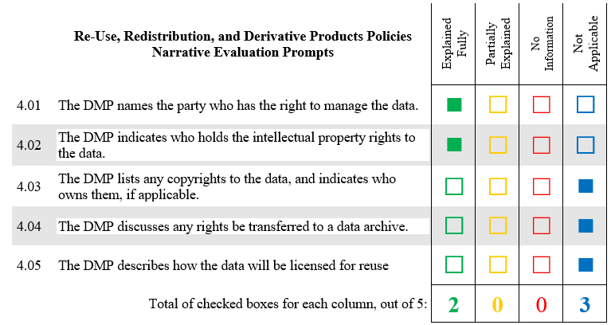
CFS 2017: 4) Reuse Policies
These data are managed by the Bureau of Transportation Statistics. The data are in the public domain and may be re-used without restriction.
Citation of the data is appreciated. Please use the following recommended citation:
U.S. Department of Transportation, Bureau of Transportation Statistics. (2020). Commodity Flow Survey (CFS) 2017 [datasets]. https://doi.org/10.21949/1522565
Notes:
Zoe: Ok, who will volunteer from breakout room 4 to share the evaluation of the Reuse Policies section? [3 to 4 minutes of input]
Thanks. Jesse will you please talk about NTL’s feedback on this section?
Jesse: For Reuse Policies, we self-scored
Explained Fully: 2
Partially Explained: 0
No Information: 0
Not Applicable: 3
Again, because of public domain, many are not applicable.
I do want to take a moment to call out a best practice here, since this is a short section. In response to the DMP template prompts “Name who has the right to manage the data,” and “Indicate who holds the intellectual property rights to the data.” I answered in complete sentences, as you can see on the slide. I wrote: “These data are managed by the Bureau of Transportation Statistics. The data are in the public domain and may be re-used without restriction.”
Remember, a DMP is meant to be a narrative knowledge management document that your team, your funder, your boss, or future data users can read and make sense of. So, using complete sentences as you write your answers will make it easier to format your PDF into a coherent narrative.
Ok, let’s move on to the last section. [Next slide]

Slide 15
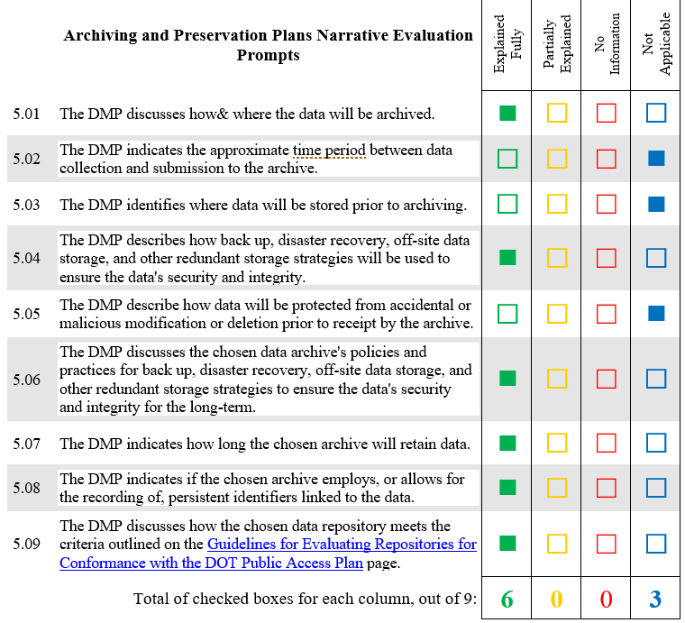
CFS 2017: 5) Archiving
The dataset will be archived in the National Transportation Library Repository and Open Science Access Portal (ROSA P). Prior to archiving, the data are stored on the secured BTS networks and drives, which are backed up nightly. The US DOT systems are secured from outside users and backed up daily.
Files in ROSA P are backed up in NTL drives at US DOT, daily; at the Centers for Disease Control, the repository managing facility, daily; and in Amazon Web Service Cloud servers in Virginia and Oregon daily.
The dataset will be retained in perpetuity.
NTL staff will mint persistent Digital Object Identifiers (DOIs) for each dataset stored in ROSA P. These DOIs will be associated with dataset documentation as soon as they become available for use.
The DOIs associated with this dataset include: https://doi.org/10.21949/1522565
The assigned DOI resolves to the repository landing page for the “Commodity Flow Survey (CFS) 2017” dataset, so that users may locate associated metadata and supporting files.
ROSA P meets all the criteria outlined on the “Guidelines for Evaluating Repositories for Conformance with the DOT Public Access Plan” page: https://ntl.bts.gov/publicaccess/evaluatingrepositories.html
Notes:
Zoe: Ok, who will volunteer from breakout room 5 to share the evaluation of the Archiving Plans section? [3 to 4 minutes of input]
Thanks. Jesse will you please talk about NTL’s feedback on this section?
Jesse: For Archiving Plans, we self-scored
Explained Fully: 6
Partially Explained: 0
No Information: 0
Not Applicable: 3
Since I was creating a “preservation DMP,” with a complete dataset in hand, instead of a “research proposal DMP,” I knew all the answers to prompts such where, how long, backup plans, and the persistent identifier.
You may not know this at the proposal phase. That is ok. This does mean that you should give it some consideration, or have a talk with your program manager.
Remember, a DMP is a living document: you can come back and add and update information as needed.
Let’s take a couple of minutes for questions before we go on to your self-evaluation time. [Next slide]

Slide 16
DMP Self-Evaluation (25 min)
Each Attendee, working alone or with co-authors
No DMP? Use one from https://rosap.ntl.bts.gov/collection_pa_dmp
Use Sufficiency Eval form
Be objective, but gentle
Get as far as you can
Feedback to NTL on checklist is welcome
Notes:
[hold here 25 minutes]
Leighton:
Now we are going to ask you to take a look at your own DMP from a different lens. Pretend you are the program manager or funder who is reading over the DMP for a research project you have proposed.
If you have co-authors, you can work as a group, or alone.
Didn’t write a DMP or want to evaluate someone else’s work? Pick a DMP from this collection in ROSA P: https://rosap.ntl.bts.gov/collection_pa_dmp
We will paste that into the chat.
Using the Sufficiency Checklist, score your DMP.
Be as objective about your DMP as possible, but be gentle. This was your first effort.
Get as far as you can in 25 minutes.
Feedback on the NTL DMP Sufficiency Checklist tool is welcome, as we want this to useful to you.
NTL staff will stay in the room to answer questions.
If you finish early, you can go on break early. We plan to get back together at the top of the hour.

Slide 17
Break: 10 Min
Notes:
[Time check: 1.50]
10 minute break
[2.00 minutes at end of break]
[NEXT SLIDE]

Slide 18
Volunteer Sharing Results (25 min)
Volunteers for:
Section 1
Section 2
Section 3
Section 4
Section 5
Notes:
[Stay on this slide for 25 minutes]
Jesse:
For this section, we would like to have some of you volunteer to come on mic or camera and talk about how you evaluated parts of your own DMP.
And if you like, after you share, the NTL team member who evaluated your DMP can tell you what they thought. If, however, you do not want live feedback, you can say so.
If you used a DMP from the ROSA P collection, you may also talk about that DMP.
We will use the same format as before, going section by section.
So I will start by asking for a volunteer to talk about section 1 of the DMP they evaluated.
[about 5 minutes per section]
Section 1
Section 2
Section 3
Section 4
Section 5
Thank you all for sharing.
Let’s start to wrap up.
[Next slide]

Slide 19
Public Access Implementation Working Group (PAIWG)
PAIWG is an OST-R RD&T Planning Team Topical Research Working Group (TRWG).
PAIWG special role: helping modes implement Public Access Plan.
Task forces:
Public Access
Publications
Data Access
PAIWG has a number of FAA participants.
We would like to have you, too.
Notes:
[1 to 2 minute]
Leighton:
I have the pleasure of serving as the chair of the US DOT Public Access Implementation Working Group (or PAIWG). PAIWG is a Topical Research Working Group under the OST-R RD&T Planning Team. The Planning Team holds monthly meetings of the research principles from each DOT mode and the director of RD&T, Firas Ibrahim. Besides the planning team, there are 12 cross-modal working groups to help coordinate, collaborate, and innovate research at DOT. The PAIWG has a special role, in helping the modes implement the DOT Public Access Plan. PAIWG has a number of FAA participants. If data management and public access are of interested to you, we would like to have you, too.
Please contact me directly.
Next, I am going to ask Zoe to talk a bit about next steps.
[Next slide]

Slide 20
NTL To Do List
Archive workshop materials in ROSA P
Email completed DMP sufficiency evals to FAA attendees
Gather questions and suggestions
Send answer through Mike and Anthony
Update and add Public Access Guidance pages
Modify DOT DMP Template to match Public Access Plan update and federal shared sections
Match Template and eval tool
Plan for next workshop (Data dictionary and README best practices?)
Notes:
[1 to 2 minutes]
Zoe:
The goal of workshop instructors is to come in, teach a bunch new skills, and then sit back while the attendees go out in implement their new skills.
However, as a result of this workshop series, we at NTL have a whole To-Do list, as you can see on the screen.
I want to highlight point 6: there is going to be an update to the Public Access Plan this year. That will mean some changes in the DMP template, including a section for managing any software created during a research project. We want to make sure you understand that these things are fluid.
NTL and the PAIWG will make sure you know about changes.
In the rest of our time together, let’s have some discussion.
[Next Slide]

Slide 21
Questions & Discussion from Sessions 1 & 2
public.access@dot.gov
Notes:
Slide Title: Questions & Discussion from Sessions 1 & 2
Live discussion will focus on Session 1 & 2 questions.
Some of these questions and responses are represented in the 8 following slides. If we do not talk about a slide in the workshop, you can read these on your own, since we have shared the slides with you.

Slide 22
Questions From Session 1: What is Data?
Question: Who or what documents determine what qualifies as "Data" explicitly? I see datasets, reports, publications, etc. being listed, but who or what ultimately determines if it's "data"?
Response: As defined by the US DOT Public Access Plan https://doi.org/10.21949/1520559, “Digital Data Sets,” for the purpose of this plan, will be defined as all scientific data collected through research projects funded, either fully or partially, by federal funds awarded through a DOT contract, grant or other agreement or collected by DOT employees. Such scientific data are the digitally recorded factual materials resulting from research that is necessary to validate research findings.” This data can be recorded in any number of formats.
As our FAQ https://doi.org/10.21949/1520567 adds: What constitutes such data will be determined by the community of interest through the process of peer review and program management. This may include, but is not limited to: data, samples, physical collections, software and models. In general, your plan should address final research data. This includes recorded factual material commonly accepted in the scientific community as necessary to validate research findings. Final research data do not include laboratory notebooks, partial datasets, preliminary analyses, drafts of scientific papers, plans for future research, peer review reports, communications with colleagues, or physical objects, such as gels or laboratory specimens.
For more Questions and Answers, see the Public Access Plan FAQ page at https://doi.org/10.21949/1520567
Notes:
Questions From Session 1: What is Data?
Question: Who or what documents determine what qualifies as "Data" explicitly? I see datasets, reports, publications, etc. being listed, but who or what ultimately determines if it's "data"?
Response: As defined by the US DOT Public Access Plan https://doi.org/10.21949/1520559, “Digital Data Sets,” for the purpose of this plan, will be defined as all scientific data collected through research projects funded, either fully or partially, by federal funds awarded through a DOT contract, grant or other agreement or collected by DOT employees. Such scientific data are the digitally recorded factual materials resulting from research that is necessary to validate research findings.” This data can be recorded in any number of formats.
As our FAQ https://doi.org/10.21949/1520567 adds: What constitutes such data will be determined by the community of interest through the process of peer review and program management. This may include, but is not limited to: data, samples, physical collections, software and models. In general, your plan should address final research data. This includes recorded factual material commonly accepted in the scientific community as necessary to validate research findings. Final research data do not include laboratory notebooks, partial datasets, preliminary analyses, drafts of scientific papers, plans for future research, peer review reports, communications with colleagues, or physical objects, such as gels or laboratory specimens.
For more Questions and Answers, see the Public Access Plan FAQ page at https://doi.org/10.21949/1520567

Slide 23
Questions From Session 1: Final Dataset?
Question: How do we define "final dataset"? Would this be the post-wrangled data with duplicates/invalid data removed? What about outliers? Where in the "data cleaning" process should we be considering the data as required for submission?
Response: The final dataset is that dataset that used to support the conclusions and analysis of research project and any research reports, journal articles, etc. This can be the cleaned dataset.
For the purposes of Public Access and the greatest sharing, this data should not contain any sensitive information, such as personally identifiable information, business intellectual property, or data that might compromise national or homeland security.
If the data must contain some sensitive information, then access should be limited. However, federal law requires the greatest possible sharing of non-sensitive data. This might mean the creation of a “Public Use File” to share, while a “limited access version” is kept secure at DOT for more robust research and analysis.
You may also find it useful to keep the raw data. If so, that raw data may need its own data management planning, as it may not be shared in a public archive. It will likely have different preservation needs.
For more Questions and Answers, see the Public Access Plan FAQ page at https://doi.org/10.21949/1520567
Notes:
Slide title: Questions From Session 1: Final Dataset?
Question: How do we define "final dataset"? Would this be the post-wrangled data with duplicates/invalid data removed? What about outliers? Where in the "data cleaning" process should we be considering the data as required for submission?
Response: The final dataset is that dataset that used to support the conclusions and analysis of research project and any research reports, journal articles, etc. This can be the cleaned dataset.
For the purposes of Public Access and the greatest sharing, this data should not contain any sensitive information, such as personally identifiable information, business intellectual property, or data that might compromise national or homeland security.
If the data must contain some sensitive information, then access should be limited. However, federal law requires the greatest possible sharing of non-sensitive data. This might mean the creation of a “Public Use File” to share, while a “limited access version” is kept secure at DOT for more robust research and analysis.
You may also find it useful to keep the raw data. If so, that raw data may need its own data management planning, as it may not be shared in a public archive. It will likely have different preservation needs.
For more Questions and Answers, see the Public Access Plan FAQ page at https://doi.org/10.21949/1520567

Slide 24
Questions From Session 1: Licensing and Rights?
Question Part A: Do have a standard data sharing license for our data?
Response Part A: By law, the research outputs of U.S. Government employees is in the Public Domain.
If the research is funded by US DOT and carried out by a third party, the DOT retains non-exclusive (joint) copyright of the research outputs.
In order to promote research sharing, we encourage funded researchers to use open licenses, such as the Creative Commons CC-BY Attribution license.
Please see our “Managing Rights” page at https://doi.org/10.21949/1520564 for more information.
Question Part B: Is there legal assistance available for completing the DMP section on Re-use, Redistribution, and Derivative Product Policies?
Response Part B: Yes. The DOT Office of General Counsel can help.
We also have training materials such as:
“Managing Rights” https://doi.org/10.21949/1520564
TRB Webinar: USDOT Public Access Plan and Data Management Primer https://doi.org/10.21949/1520568
U.S. DOT Public Access and Data Management Review https://doi.org/10.21949/1503909
For more Questions and Answers, see the Public Access Plan FAQ page at https://doi.org/10.21949/1520567
Notes:
Slide title: Questions From Session 1: Licensing and Rights?
Question Part A: Do have a standard data sharing license for our data?
Response Part A: By law, the research outputs of U.S. Government employees is in the Public Domain.
If the research is funded by US DOT and carried out by a third party, the DOT retains non-exclusive (joint) copyright of the research outputs.
In order to promote research sharing, we encourage funded researchers to use open licenses, such as the Creative Commons CC-BY Attribution license.
Please see our “Managing Rights” page at https://doi.org/10.21949/1520564 for more information.
Question Part B: Is there legal assistance available for completing the DMP section on Re-use, Redistribution, and Derivative Product Policies?
Response Part B: Yes. The DOT Office of General Counsel can help.
We also have training materials such as:
“Managing Rights” https://doi.org/10.21949/1520564
TRB Webinar: USDOT Public Access Plan and Data Management Primer https://doi.org/10.21949/1520568
U.S. DOT Public Access and Data Management Review https://doi.org/10.21949/1503909
For more Questions and Answers, see the Public Access Plan FAQ page at https://doi.org/10.21949/1520567

Slide 25
Questions From Session 1: Training for CORs?
Question: Is there any similar material or training for Legal or Acquisitions (CORs, COs)?
Response: Yes. NTL staff gave a training entitled “How Acquisition Professionals Fit into the USDOT Public Access Plan” at the 7th Annual DOT Acquisition & Financial Assistance Conference in 2018.
This training can be updated and presented as needed.
Please contact public.access@dot.gov to schedule a training.
For more Questions and Answers, see the Public Access Plan FAQ page at https://doi.org/10.21949/1520567
Notes:
Slide Title: Questions From Session 1: Training for CORs?
Question: Is there any similar material or training for Legal or Acquisitions (CORs, COs)?
Response: Yes. NTL staff gave a training entitled “How Acquisition Professionals Fit into the USDOT Public Access Plan” at the 7th Annual DOT Acquisition & Financial Assistance Conference in 2018.
This training can be updated and presented as needed.
Please contact public.access@dot.gov to schedule a training.
For more Questions and Answers, see the Public Access Plan FAQ page at https://doi.org/10.21949/1520567

Slide 26
Questions From Session 1: Lit Reviews?
Question Part A: Does a narrative review of the scientific literature require a DMP?
Response: Probably not, if it is only a narrative. However, you are performing text mining, natural language processing, or other computational actions, which might lead to a machine-readable corpus or database, you may want to consider a DMP.
A DMP for that kind of data can help protect against loss.
Further, sharing a large textual corpus may have interest to other transportation researchers.
Question Part B: To extend the question above, if there is a more structured output from a literature review (think a spreadsheet containing citations, keywords, and a 1-line summary) would this be something we should submit as "data" for the sake of DMP/Public Access?
Response Part B: Again, it depends on use. Just a spreadsheet bibliography, probably not. However, as an analyzed or analyzable corpus for research trend analysis, then yes.
For more Questions and Answers, see the Public Access Plan FAQ page at https://doi.org/10.21949/1520567
Notes:
Slide title: Questions From Session 1: Lit Reviews?
Question Part A: Does a narrative review of the scientific literature require a DMP?
Response: Probably not, if it is only a narrative. However, you are performing text mining, natural language processing, or other computational actions, which might lead to a machine-readable corpus or database, you may want to consider a DMP.
A DMP for that kind of data can help protect against loss.
Further, sharing a large textual corpus may have interest to other transportation researchers.
Question Part B: To extend the question above, if there is a more structured output from a literature review (think a spreadsheet containing citations, keywords, and a 1-line summary) would this be something we should submit as "data" for the sake of DMP/Public Access?
Response Part B: Again, it depends on use. Just a spreadsheet bibliography, probably not. However, as an analyzed or analyzable corpus for research trend analysis, then yes.
For more Questions and Answers, see the Public Access Plan FAQ page at https://doi.org/10.21949/1520567

Slide 27
Questions From Session 1: Continuous Data?
Question: We collect a ton of data monitoring displacement gages over months of testing. If we publish a plot generated via that data, is it expected that all raw data is stored in a public location?
Response: Is this research data? The Public Access Plan would only require the sharing of the data used to generate the specific plot as part of a research project or as a research output.
Non-research data should follow the DOT Data Release Policy DOT 1351.34 or any orders or policy that might supersede it.
Your office or program may consider that public access to the continuous data would be in the interest of the DOT and the public. You should contact the DOT Chief Data Officer for that discussion, as it is outside the scope of the Public Access Plan.
For more Questions and Answers, see the Public Access Plan FAQ page at https://doi.org/10.21949/1520567
Notes:
Slide title: Questions From Session 1: Continuous Data?
Question: We collect a ton of data monitoring displacement gages over months of testing. If we publish a plot generated via that data, is it expected that all raw data is stored in a public location?
Response: Is this research data? The Public Access Plan would only require the sharing of the data used to generate the specific plot as part of a research project or as a research output.
Non-research data should follow the DOT Data Release Policy DOT 1351.34 or any orders or policy that might supersede it.
Your office or program may consider that public access to the continuous data would be in the interest of the DOT and the public. You should contact the DOT Chief Data Officer for that discussion, as it is outside the scope of the Public Access Plan.
For more Questions and Answers, see the Public Access Plan FAQ page at https://doi.org/10.21949/1520567

Slide 28
Questions From Session 1: How soon does data need to be released?
Question: If you plan to do a follow-up analysis on the data, to what extent is it permissible to delay data release, to avoid having duplication of efforts by others on work already being conducted in the DOT?
Response: The DOT Public Access Plan https://doi.org/10.21949/1520559 Section 4.2 specifically directs DOT employees to the Departmental Data Release Policy: https://www.transportation.gov/digitalstrategy/policyarchive/Departmental-Data-Release-Policy Basically, non-classified data should be released as quickly as possible.
For more Questions and Answers, see the Public Access Plan FAQ page at https://doi.org/10.21949/1520567
Notes:
Slide title: Questions From Session 1: How soon does data need to be released?
Question: If you plan to do a follow-up analysis on the data, to what extent is it permissible to delay data release, to avoid having duplication of efforts by others on work already being conducted in the DOT?
Response: The DOT Public Access Plan https://doi.org/10.21949/1520559 Section 4.2 specifically directs DOT employees to the Departmental Data Release Policy: https://www.transportation.gov/digitalstrategy/policyarchive/Departmental-Data-Release-Policy Basically, non-classified data should be released as quickly as possible.
For more Questions and Answers, see the Public Access Plan FAQ page at https://doi.org/10.21949/1520567

Slide 29
Questions From Session 1: Limiting Data Access?
Question: Regarding informed consent - is the “Access Policies” section where we could describe that human subjects data would be shared only with researchers performing research aligning with the original purpose to which consent was given?
Response: Yes. As the “Access Policies” guidance section of the Creating Data Management Plans for Intramural Research page https://doi.org/10.21949/1520572 notes, this is the part of a Data Management Plan where any restrictions on data access should be explained. Therefore, you can be in compliance with the DOT Public Access Plan while limiting access to research data.
However, U.S. government policy is to share as much data as possible with the public. Therefore, you may consider creating a “public use data” file, that has all sensitive data anonymized, while still limiting access to sensitive data.
U.S. government policy can be described as making data as open as possible, while still protecting personal, business, and national/homeland security information and data.
For more Questions and Answers, see the Public Access Plan FAQ page at https://doi.org/10.21949/1520567
Notes:
Slide title: Questions From Session 1: Limiting Data Access?
Question: Regarding informed consent - is the “Access Policies” section where we could describe that human subjects data would be shared only with researchers performing research aligning with the original purpose to which consent was given?
Response: Yes. As the “Access Policies” guidance section of the Creating Data Management Plans for Intramural Research page https://doi.org/10.21949/1520572 notes, this is the part of a Data Management Plan where any restrictions on data access should be explained. Therefore, you can be in compliance with the DOT Public Access Plan while limiting access to research data.
However, U.S. government policy is to share as much data as possible with the public. Therefore, you may consider creating a “public use data” file, that has all sensitive data anonymized, while still limiting access to sensitive data.
U.S. government policy can be described as making data as open as possible, while still protecting personal, business, and national/homeland security information and data.
For more Questions and Answers, see the Public Access Plan FAQ page at https://doi.org/10.21949/1520567

